Slide 1

NIGHT BITE NEXUS
P.NANDINI
22CD3021

Slide 2
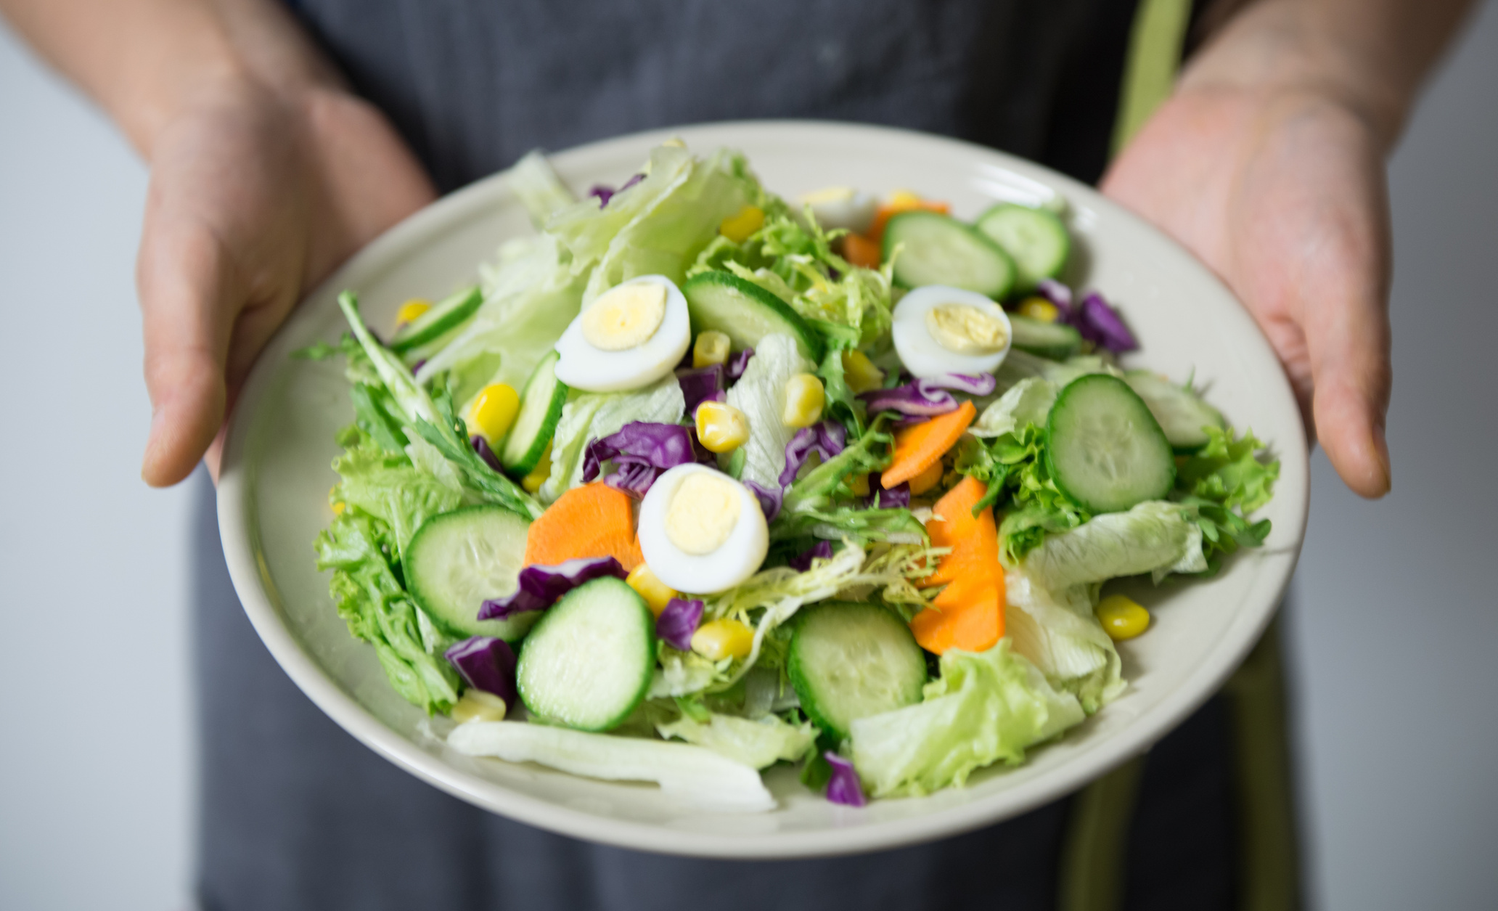
OVERVIEW
NIGHT BITE NEXUS IS AN INNOVATIVE ONLINE PLATFORM DESIGNED TO STREAMLINE THE PROCESS OF ORDERING FOOD FROM THE CAMPUS CANTEEN.
it offers students, faculty, and staff the convenience of placing orders for their favorite meals with just a few clicks, eliminating the need to wait in long
queues
queues

Slide 3
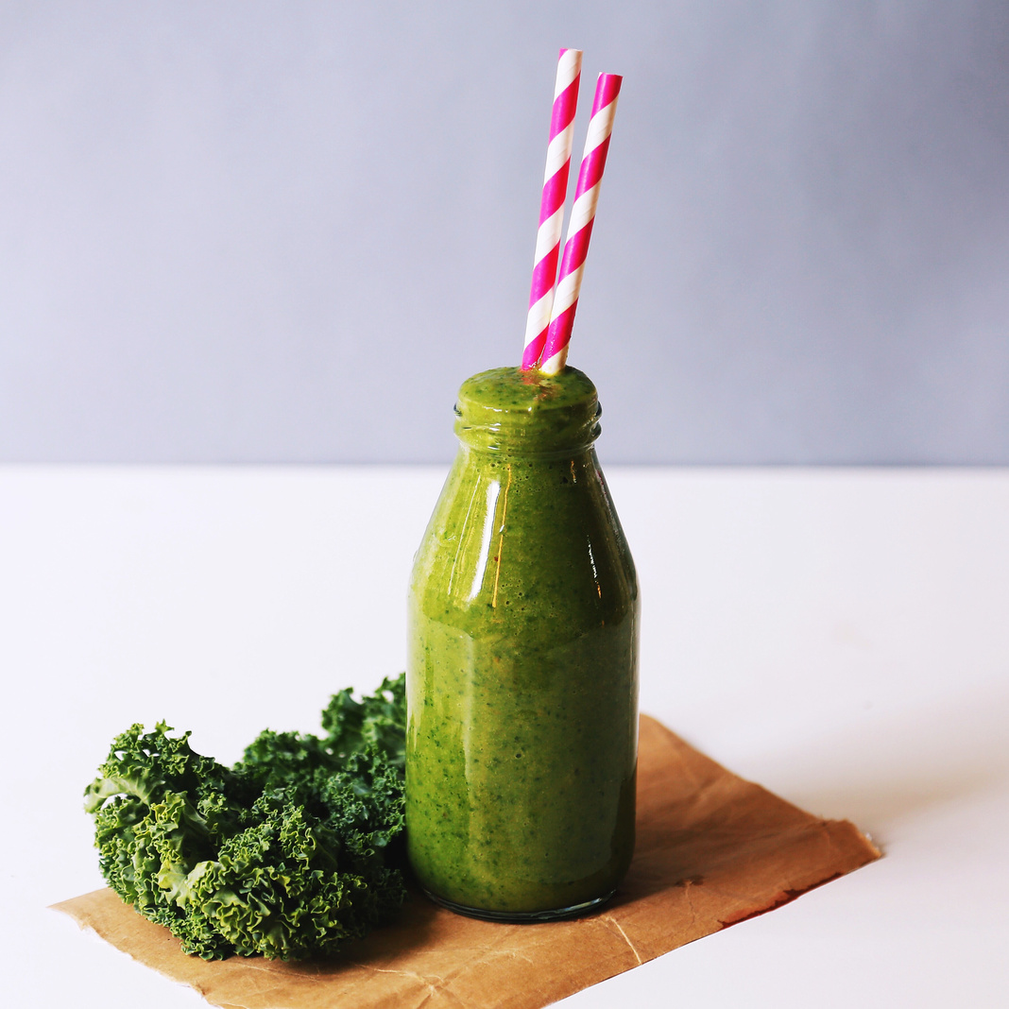
PURPOSE
Night Bite Nexus is an innovative online platform designed to streamline the process of ordering food from the campus canteen.
it offers students, faculty, and staff the convenience of placing orders for their favorite meals with just a few clicks, eliminating the need to wait in long
queues

Slide 4

TECHNOLOGIES USED:
•HTML, CSS, JavaScript: Frontend Development
•Node.js: Backend Development
•Database: ( e.g. MongoDB, MySQL)

Slide 5
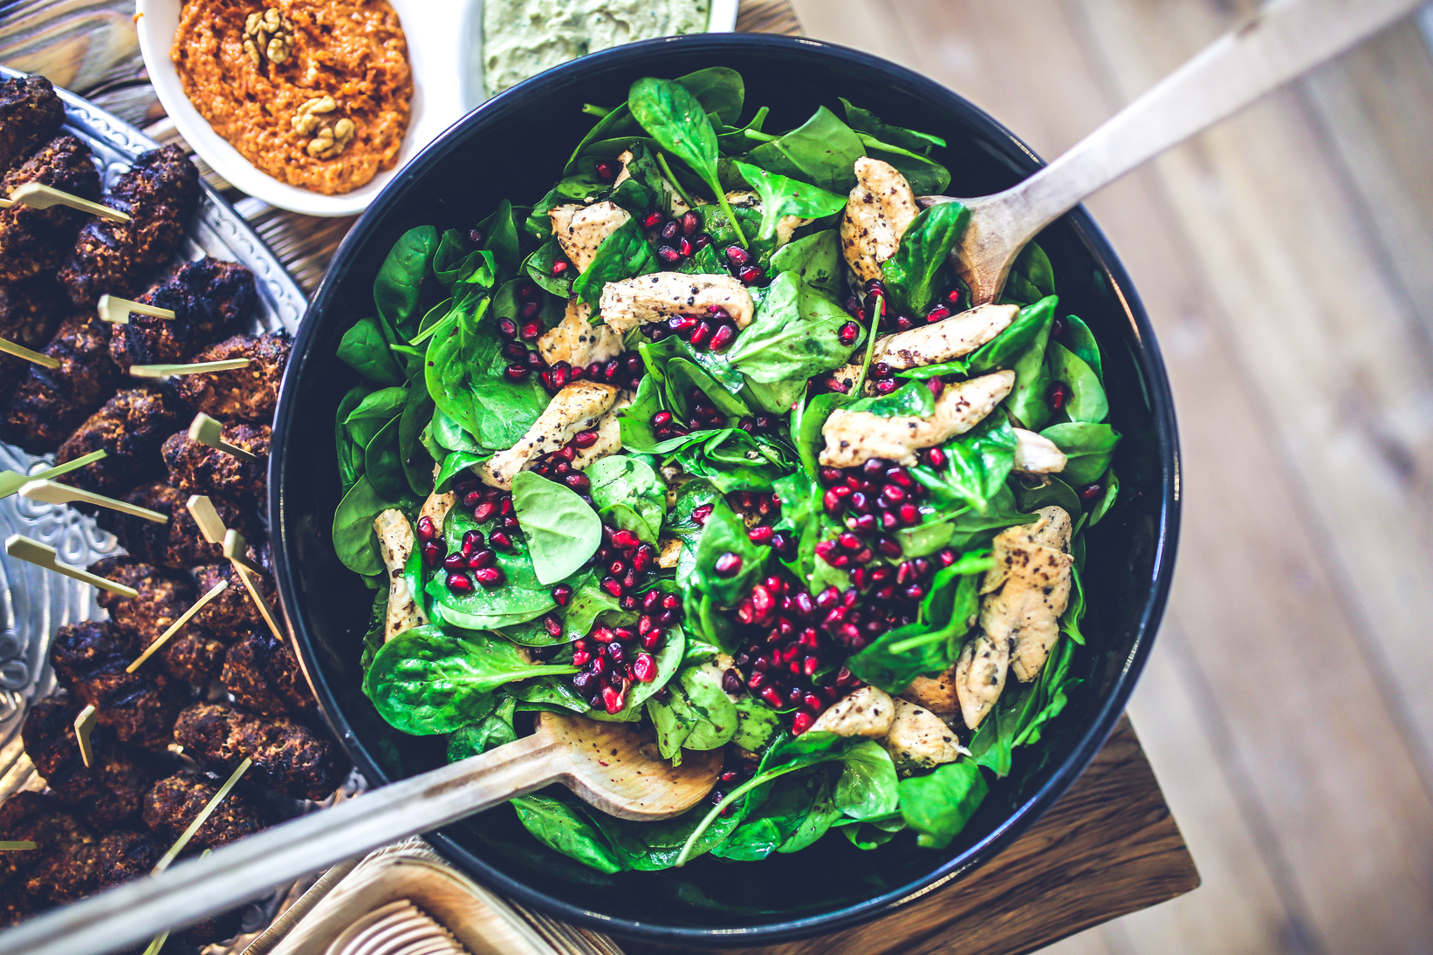
KEY CONCEPTS:
⚬USER REGISTRATION/LOGIN
⚬Menu Display and Item Selection
⚬Cart Management
⚬Payment Gateway Integration
Feedback and Rating System

Slide 6
FRONTEND FLOW
2. Item Selection and Cart Management:
Users browse through items displayed on the main page and add items to their cart by clicking the "Add to Cart" button.
The cart is dynamically updated to reflect the added items, and users can view their cart contents by clicking on the cart icon.
1. User Registration and Login:
Users access the website and are prompted to sign up or log in.
They are directed to the sign-up or sign-in form(signup.html or signin.html).
Upon successful registration or login, users are redirected to the main page to browse items.

Slide 7
FRONTEND FLOW
3. Cart Review and Checkout:
Users review the items in their cart, modify quantities if necessary, and proceed to checkout.
Upon clicking the "Checkout" button, users are directed to the payment page.
4. Payment Processing via Razorpay:
Users are presented with a payment form where they enter their payment details.
After entering the payment information, users click on the "Pay Now" button to initiate payment processing through Razorpay.

Slide 8
BACKEND FLOW
1. User Authentication and Authorization:
When users sign up, their registration details (username, email, hashed password) are stored securely in MongoDB.
Upon login, the backend verifies the user's credentials against the stored data in MongoDB.
Session tokens are generated upon successful authentication and stored on the client-side to maintain user authentication state.
2. Cart Management and Order Processing:
The backend receives requests from the frontend to add, update, or remove items from the user's cart.
Cart data is stored in MongoDB, associated with the user's session or user ID.
Upon checkout, the backend retrieves the user's cart data and initiates order processing.

Slide 9
BACKEND FLOW
3. Integration with Razorpay for Payment Processing:
Upon receiving the payment request from the frontend, the backend initiates payment processing through Razorpay's APIs.
Transaction details, including the payment status, are securely stored in MongoDB.
The backend receives payment confirmation or failure callbacks from Razorpay and updates the order status accordingly in the database.
Database Management:
MongoDB is used to store user authentication data (e.g., usernames, hashed passwords), cart information, and order details.
User data, cart contents, and order information are stored in separate collections within MongoDB.
MongoDB ensures data integrity, scalability, and flexibility for managing user-related data and order processing.

Slide 10
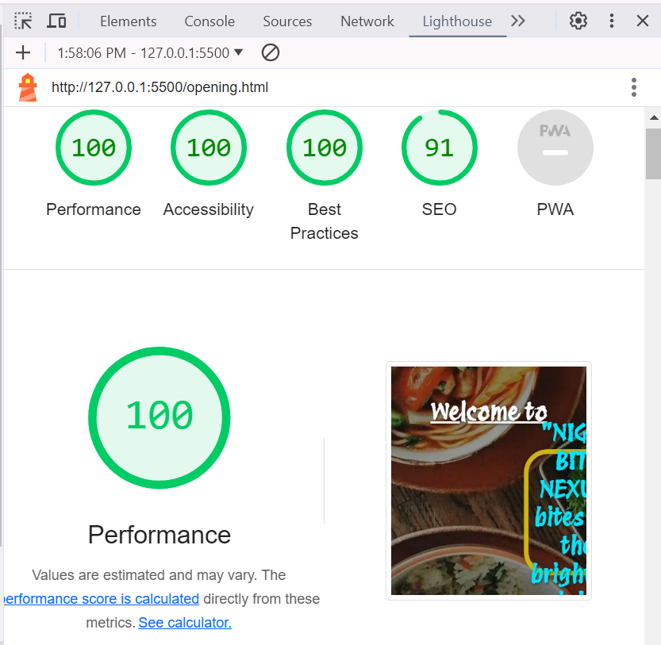
PERFORMANCE OPTMIZATION
Performance Metrics:
First Contentful Paint: 1.5 seconds
Largest Contentful Paint: 1.5 seconds
Total Blocking Time: 0 ms
Cumulative Layout Shift: 0.012
Speed Index: 1.5 seconds

Slide 11
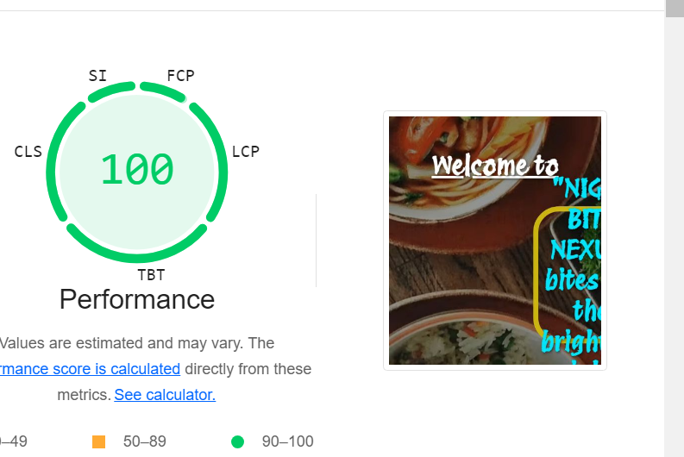
PERFORMANCE OPTMIZATION
Night Bite Nexus demonstrates excellent performance, with a perfect score of 100% for performance, accessibility, and best practices,
Accessibility and SEO Scores:
Accessibility: 100%
SEO: 91%
Comparison: Website performance metrics, accessibility, and SEO scores were compared against industry benchmarks and competitors, revealing its superiority in these areas

Slide 12
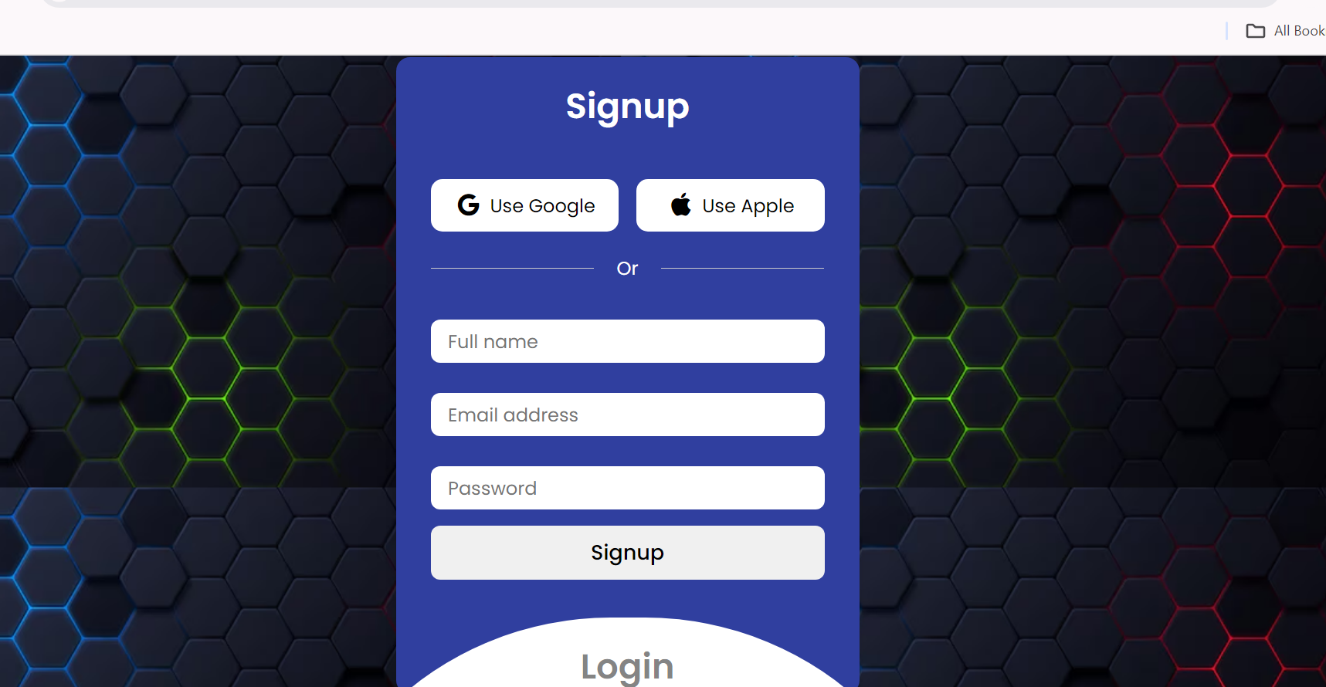
LOGIN PAGE:

Slide 13
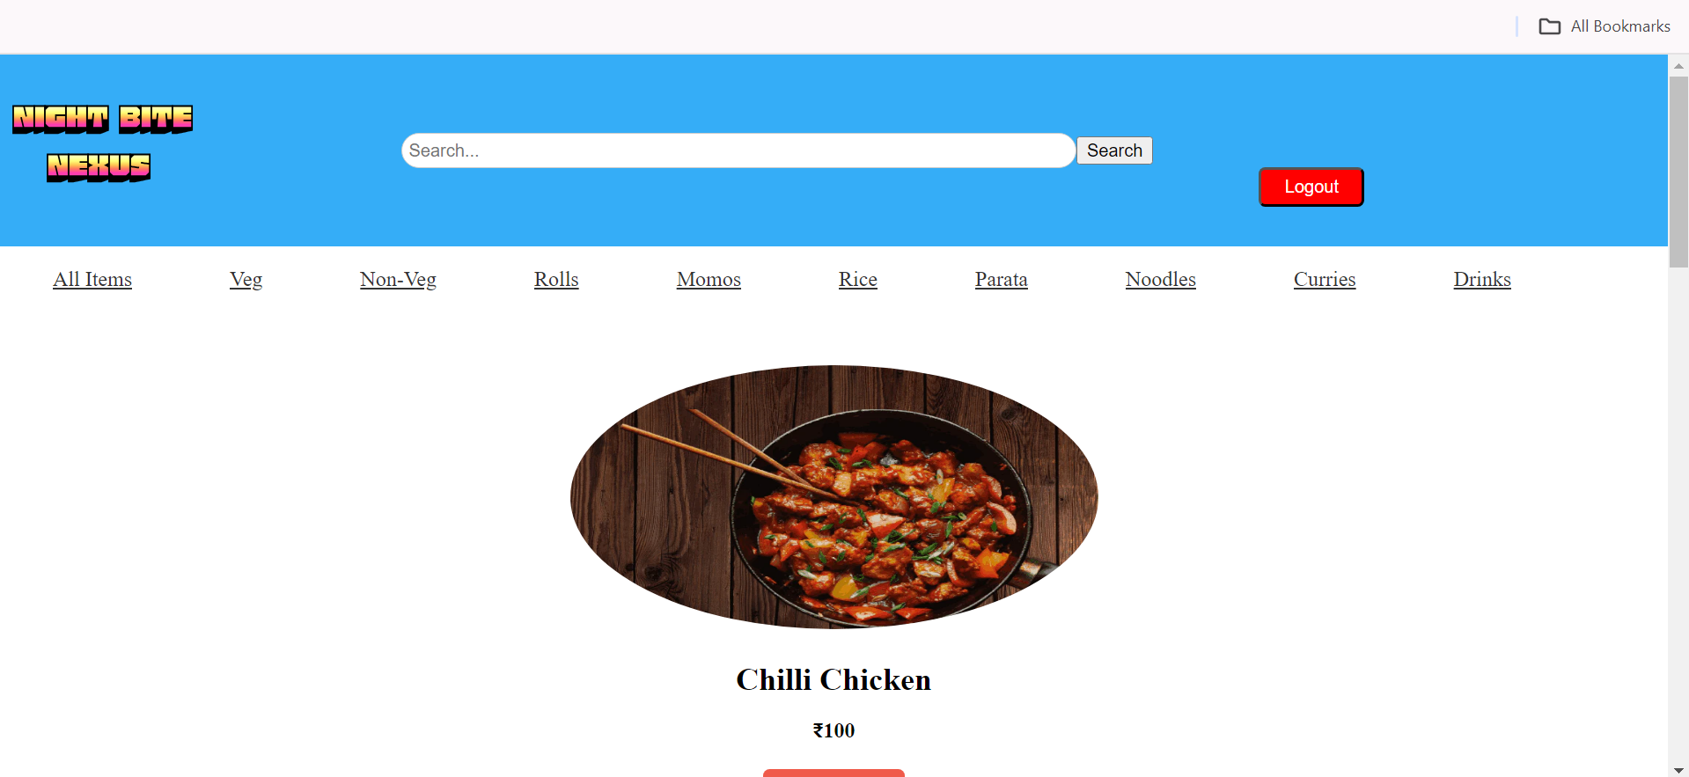
WEB PAGE:

Slide 14
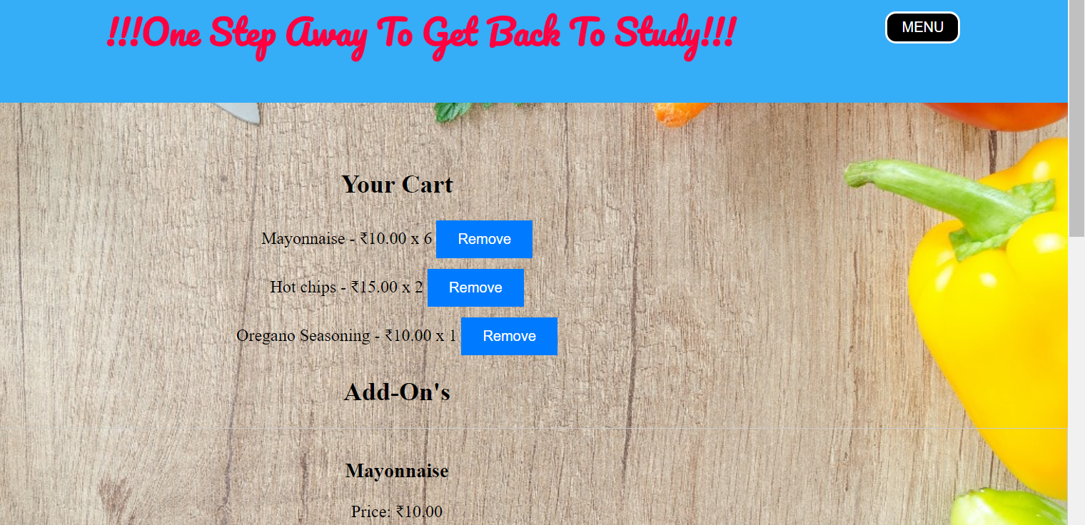
CART PAGE :

Slide 15
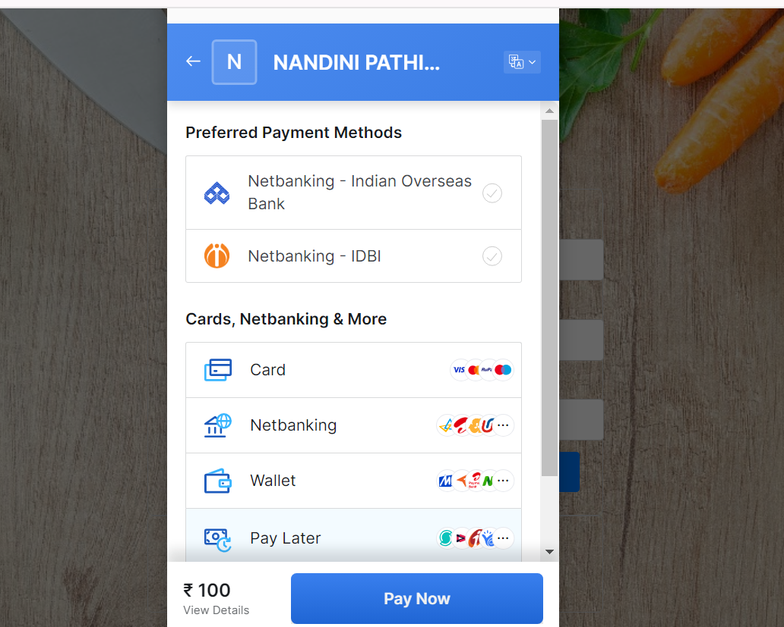
PAYMENT PAGE :

Slide 16

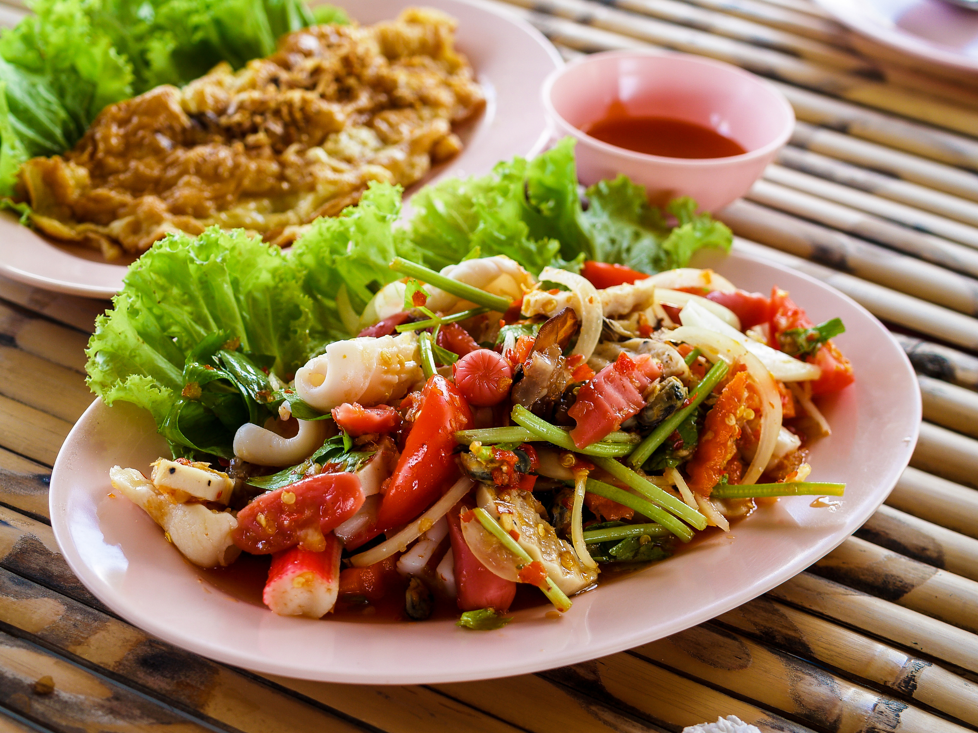

THANK YOU

